Slide 1



INVENTORY MANAGEMENT SYSTEM

Slide 2

Introduction
An Inventory Management System is software used to efficiently track, manage and control an organization’s stock. It monitors inventory levels in real time, records product details, and tracks stock movement to avoid overstocking or stockouts. By automating processes, it improves accuracy, reduces manual errors, and saves time. The system also supports product updates, stock entries, reports and reorder alerts, helping businesses make better decisions and maintain smooth operations.

Slide 3

Motivation
Manual inventory tracking is time-consuming and prone to errors such as overstocking and stock shortages.
Lack of real-time stock visibility leads to delayed decisions and operational inefficiencies.
Difficulty in tracking product movement, suppliers, and orders affects business productivity.
An automated Inventory Management System ensures accurate stock control, faster operations, and better decision-making.
The system improves efficiency, reduces human errors, and supports smooth business operations through centralized data management.

Slide 4
Role-Based Modules in Inventory Management System
Customer Module
Staff Module
Admin Module

Slide 5


Customer Module
Key Features:
User Registration: New customers can create an account.
Login & Authentication: Secure login for existing users.
View Products: Customers can browse all available products.
Place Orders: Users can place orders for the selected products.
Email Notifications:
Customers receive an email when an order is placed.
Admin receives a low-stock alert email when product quantity is low

Slide 6
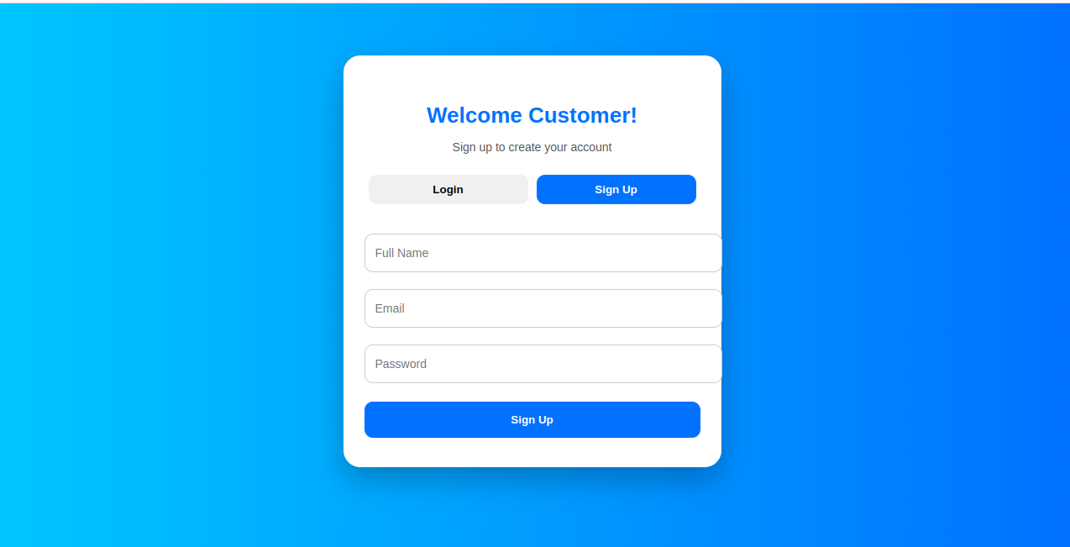
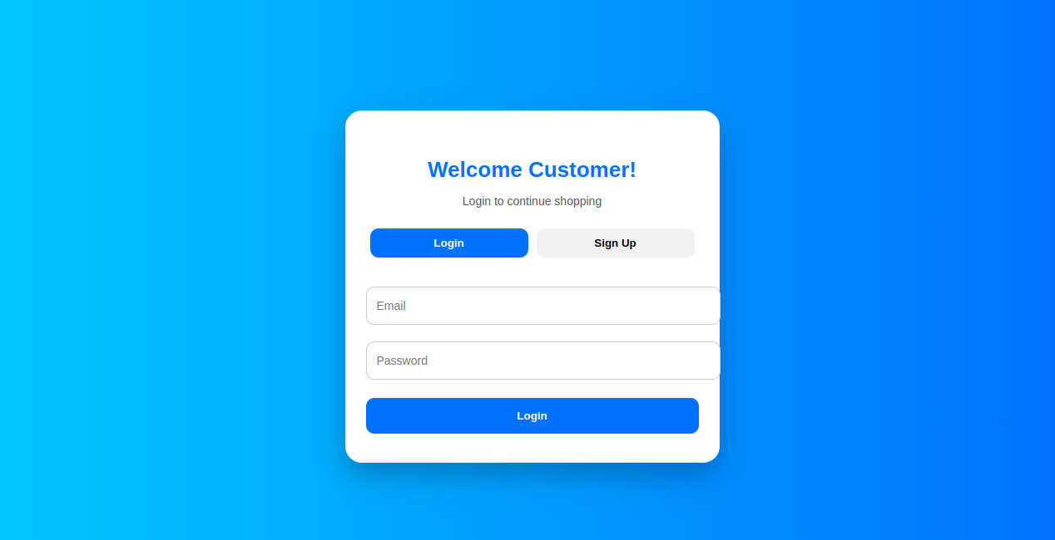
Customer Login and Sign Up Page

Slide 7
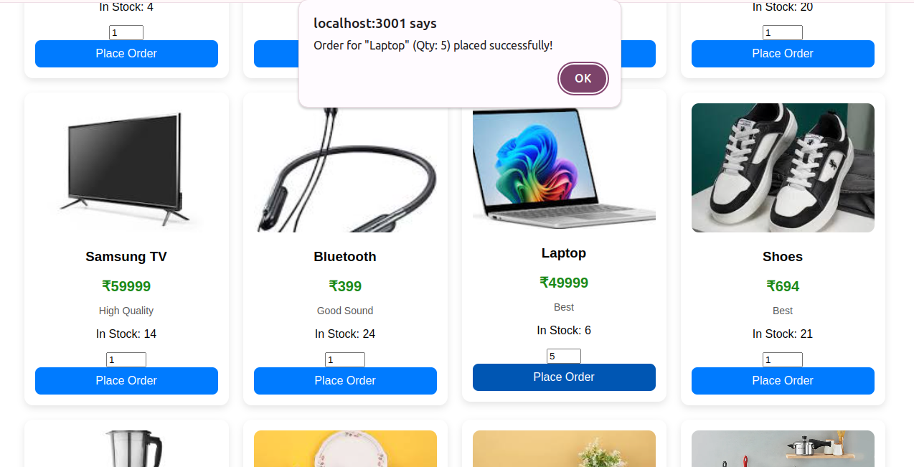
Customer views all products and places an order for the product ‘Laptop’ with a quantity of 5.

Slide 8
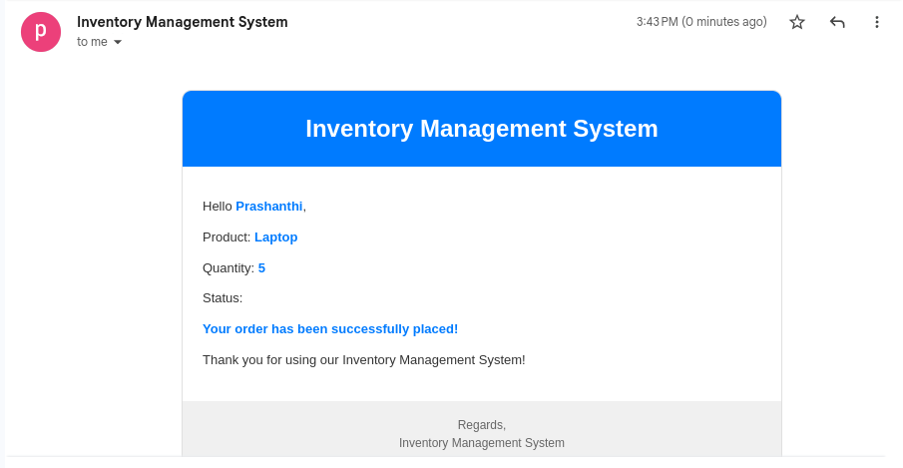
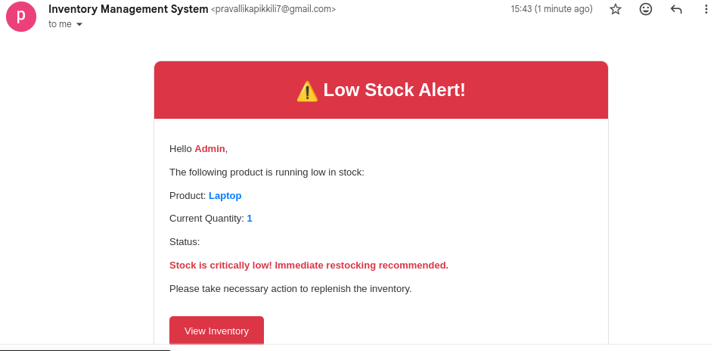
“Order Confirmation Email sent to the customer after placing an order”
“A low stock alert email is sent to the admin when the stock quantity falls below 2"

Slide 9
Staff Module
Key Features of Staff Module
User Account Features – Register, login and manage profile securely.
Purchase and Sell Inventory: Manage stock-in and stock-out operations.
View Products: Check product details and available stock.
Access & Download Files: Download reports, invoices, or related documents.
Make Transactions: Record and process sales or purchase transactions.

Slide 10
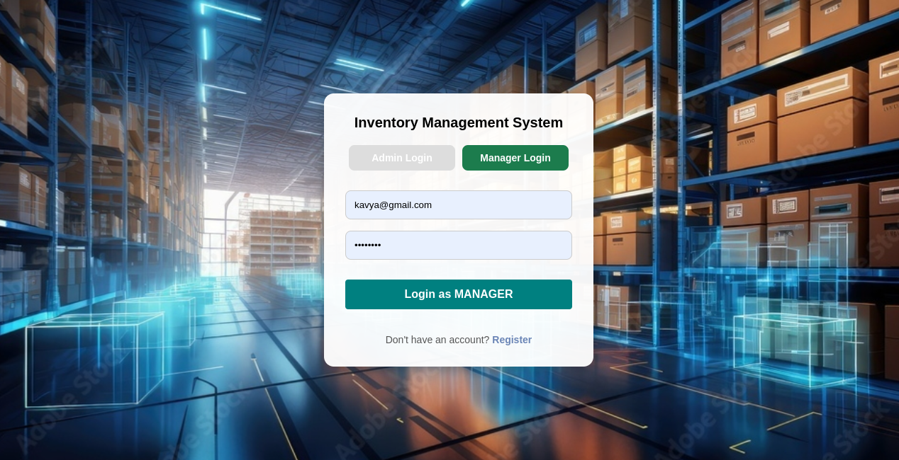
Staff Login and Register Page

Slide 11
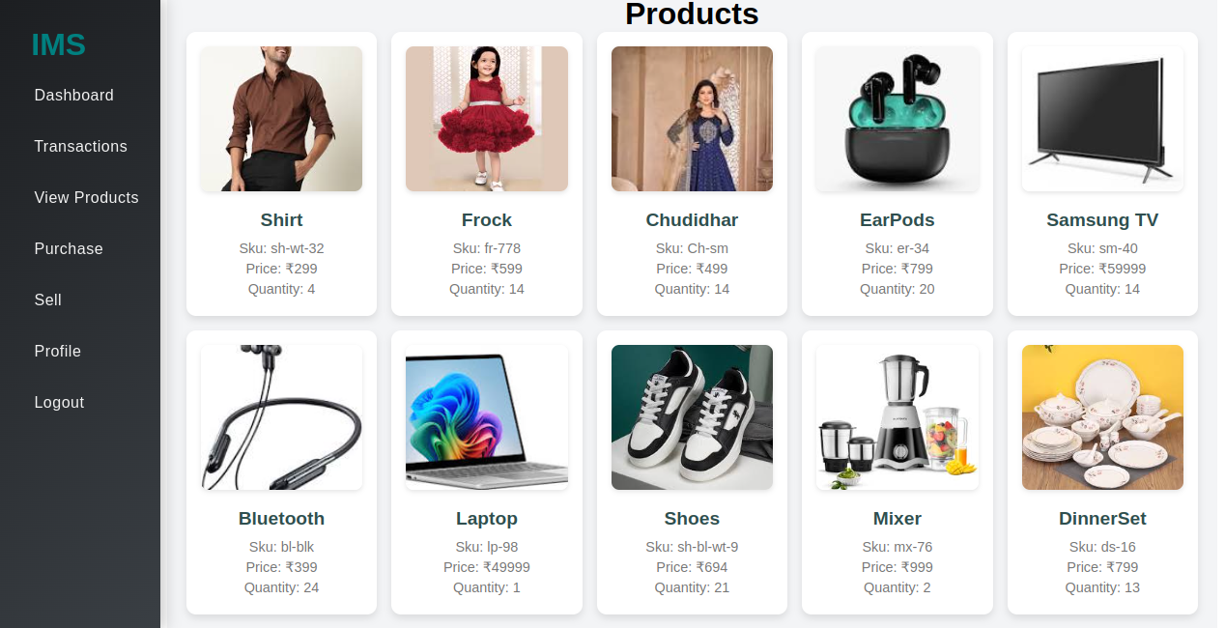
Staff can view all products and their stock details.

Slide 12
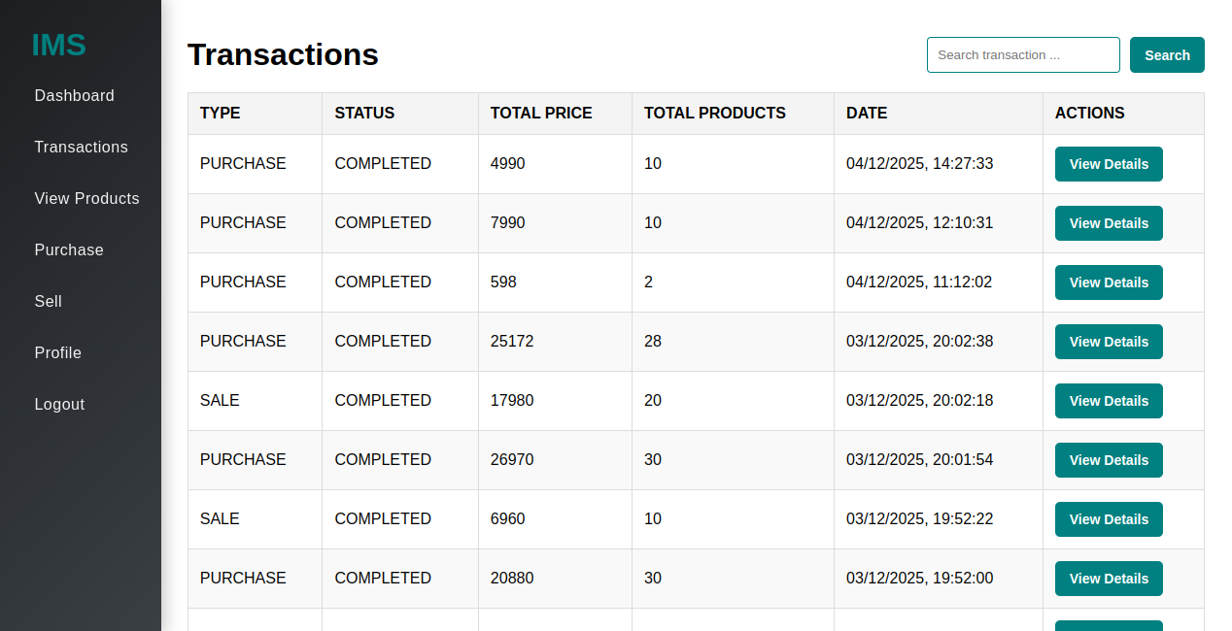
Staff can view all transactions to manage sales and purchases.

Slide 13
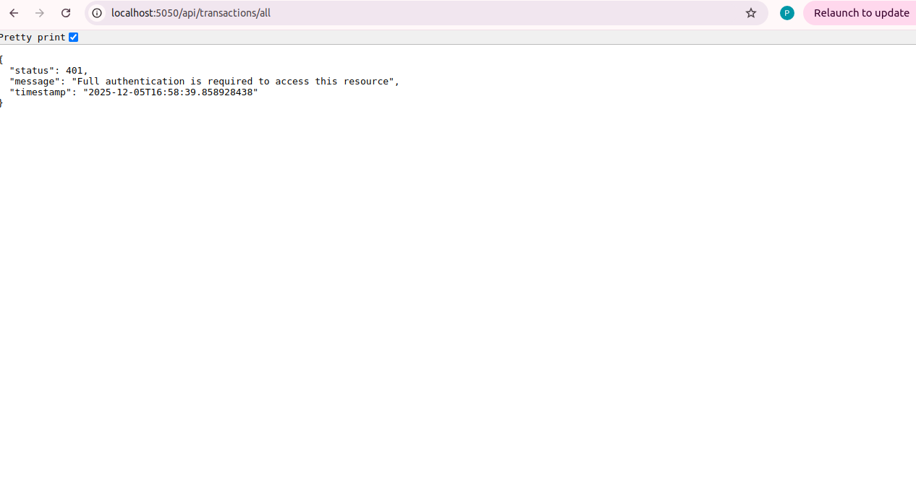
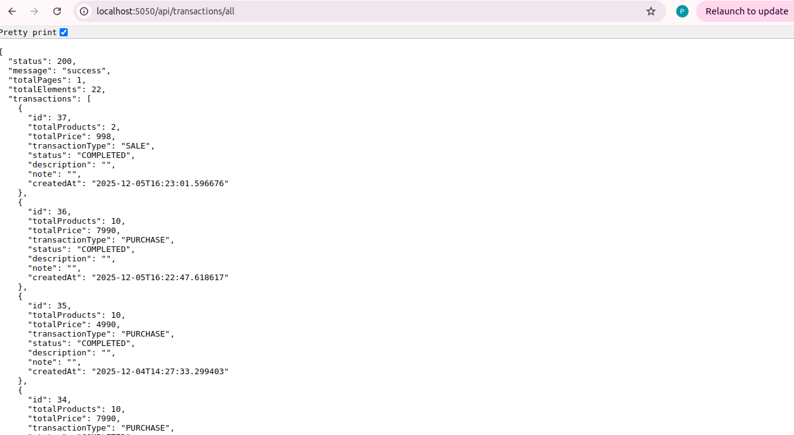
Transactions API

Slide 14
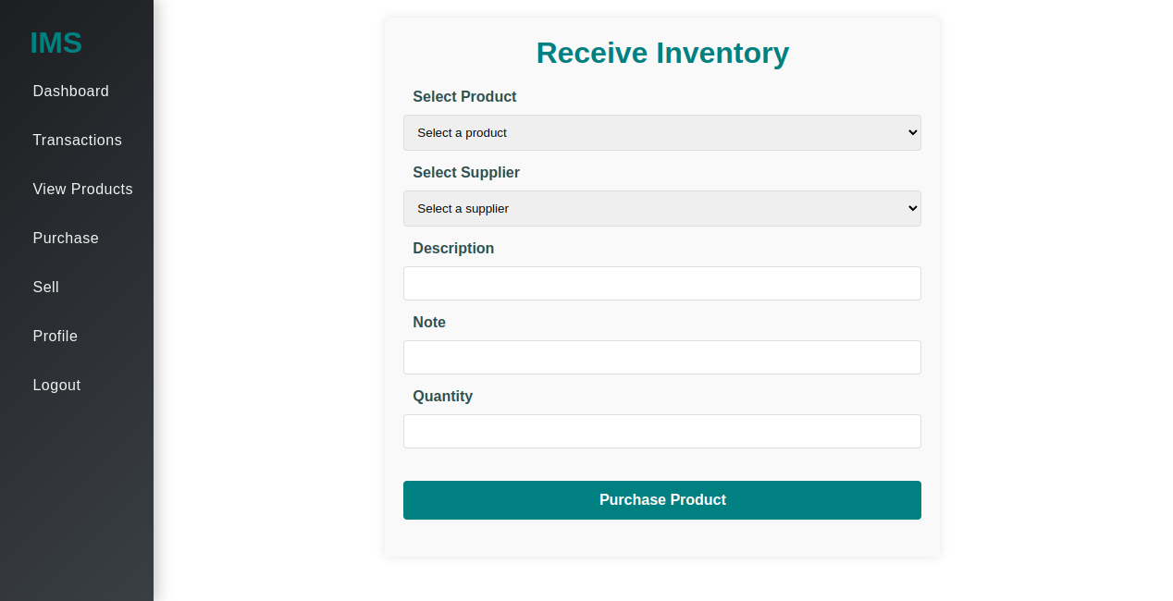
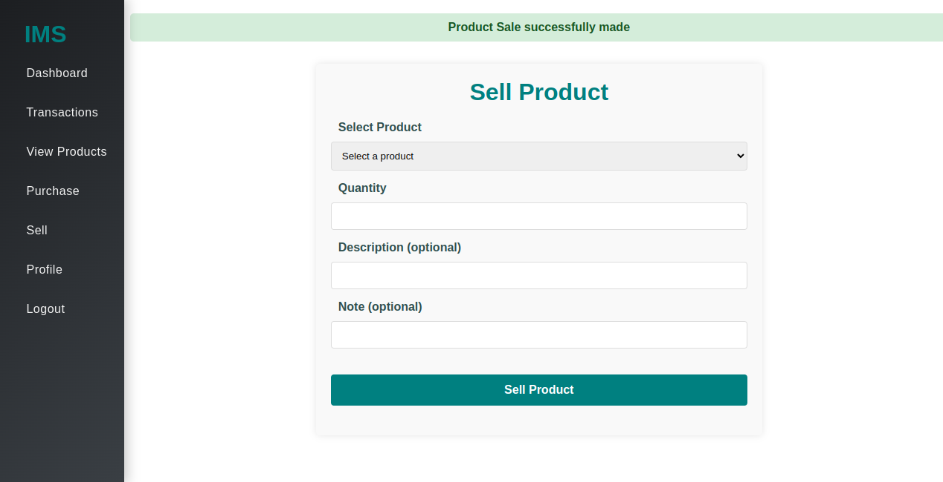
Staff can make transactions to manage sales and purchases.

Slide 15
Admin Module
Key Features of Admin Module
Product Management: Add, update, and delete products.
Stock Management: Monitor stock levels, manage stock-in and stock-out.
Staff Management: Create and manage staff and customer accounts, assign roles and permissions.
Supplier Management: Maintain supplier details and manage purchase orders.
Order & Transaction Management: Oversee sales and purchase transactions.
Reports & Analytics: Generate stock, sales, and low-stock reports for decision-making.
Email Notifications: Receive low-stock alerts and send notifications to customers.
Dashboard: View overall system statistics and quick insights.
Audit & Activity Logs: Track user actions and maintain accountability.
.

Slide 16
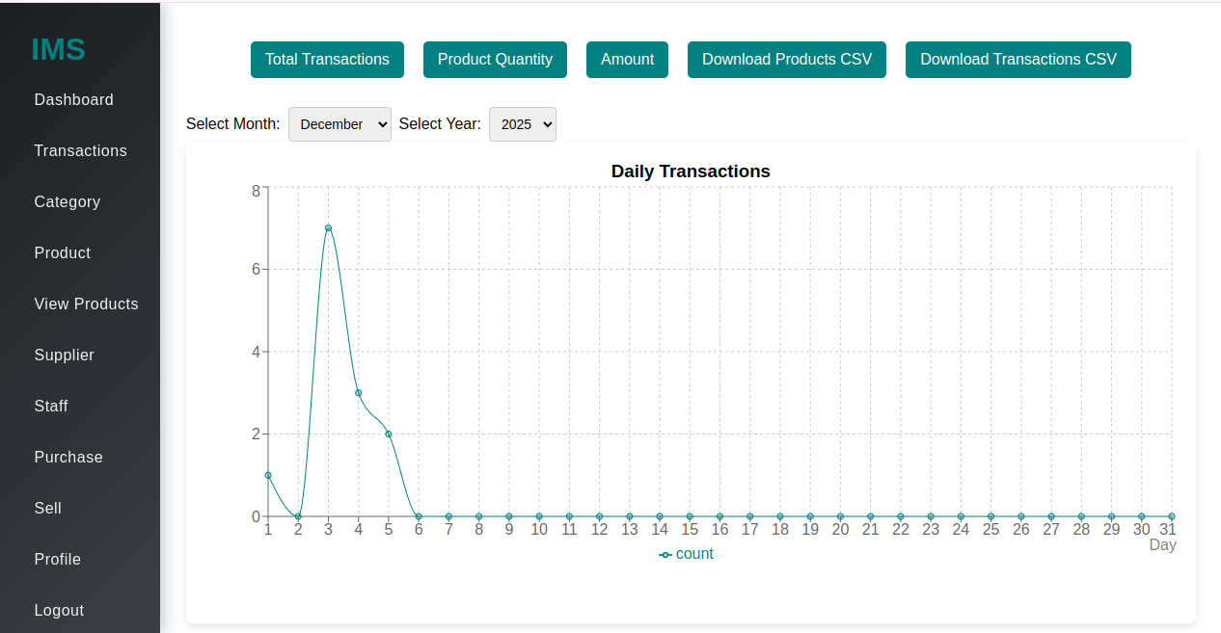
Centralized Control for Seamless Inventory Management

Slide 17
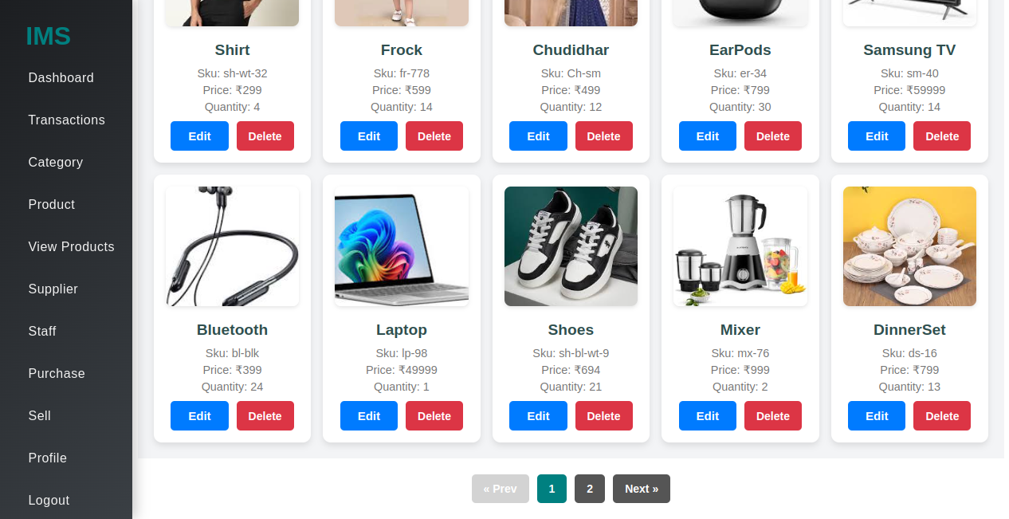
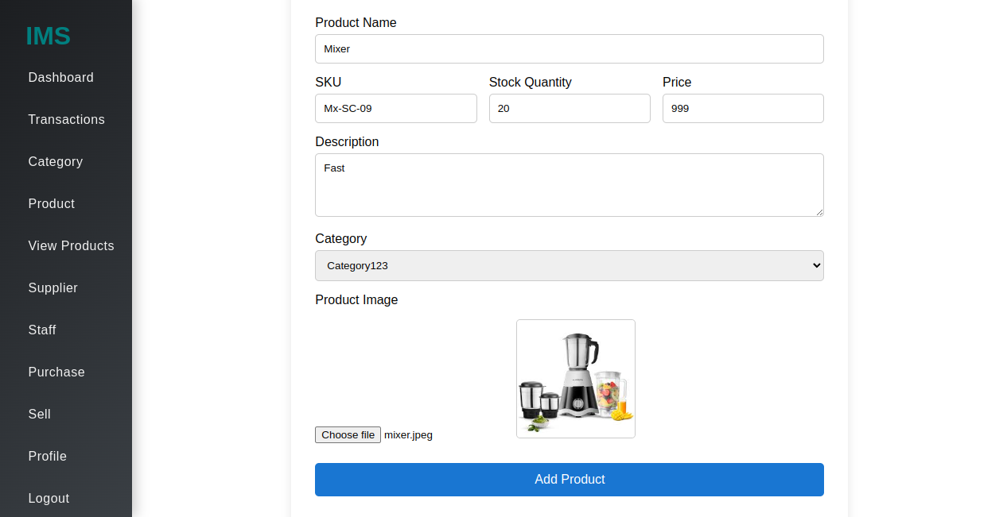
“Add, Edit, and Delete Products – Simple and Efficient Inventory Control”

Slide 18
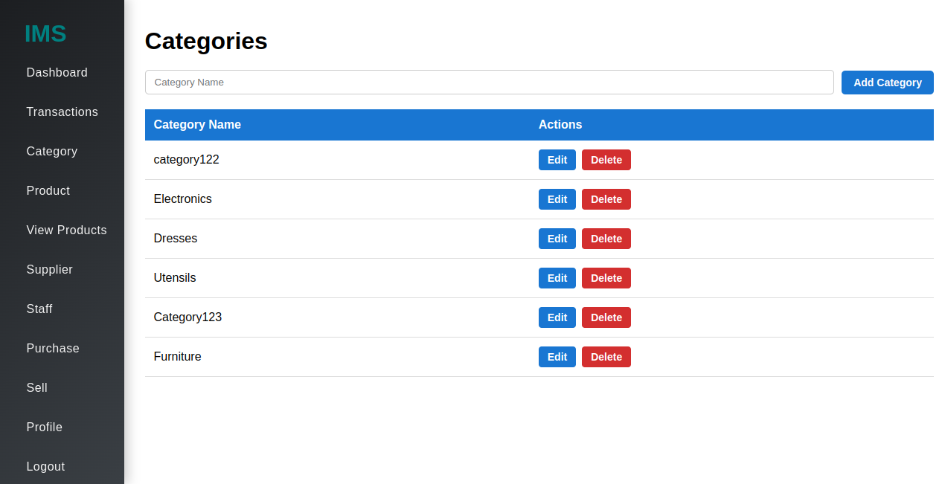
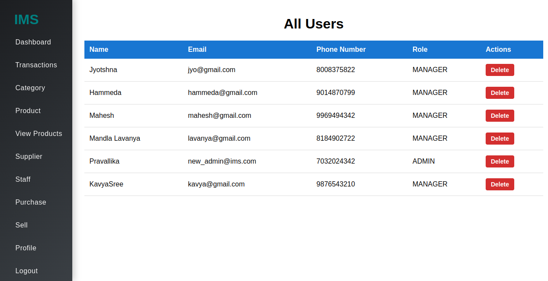
Organize Products Efficiently with Category Management
Efficient Staff Management

Slide 19
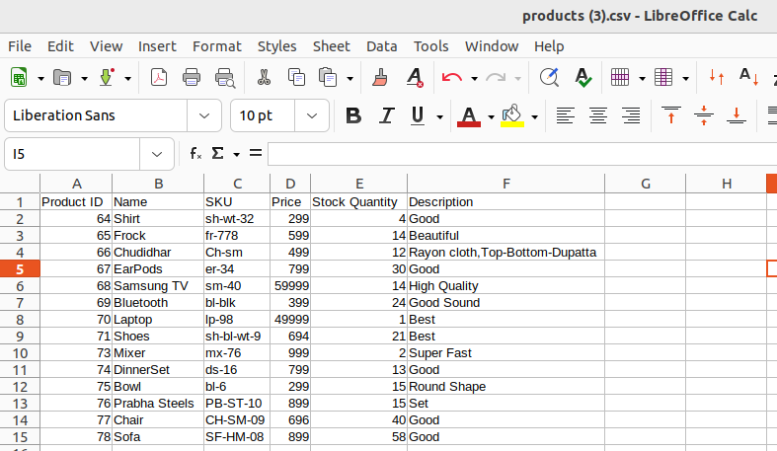
Products.csv File

Slide 20
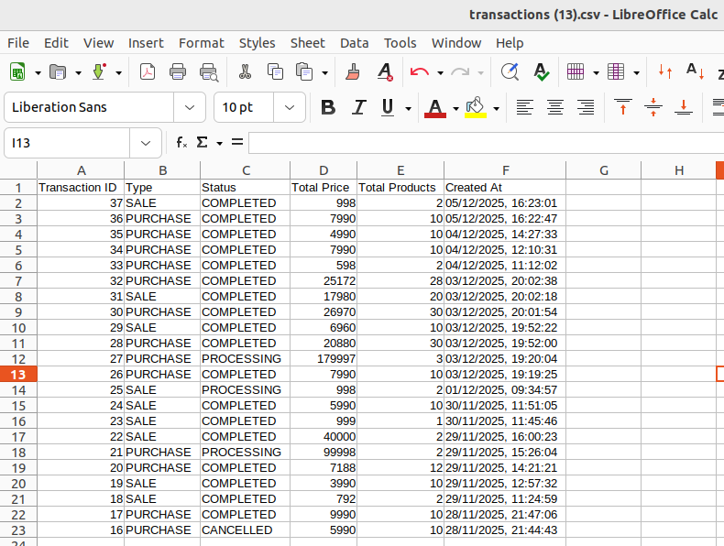
Transactions.csv File

Slide 21
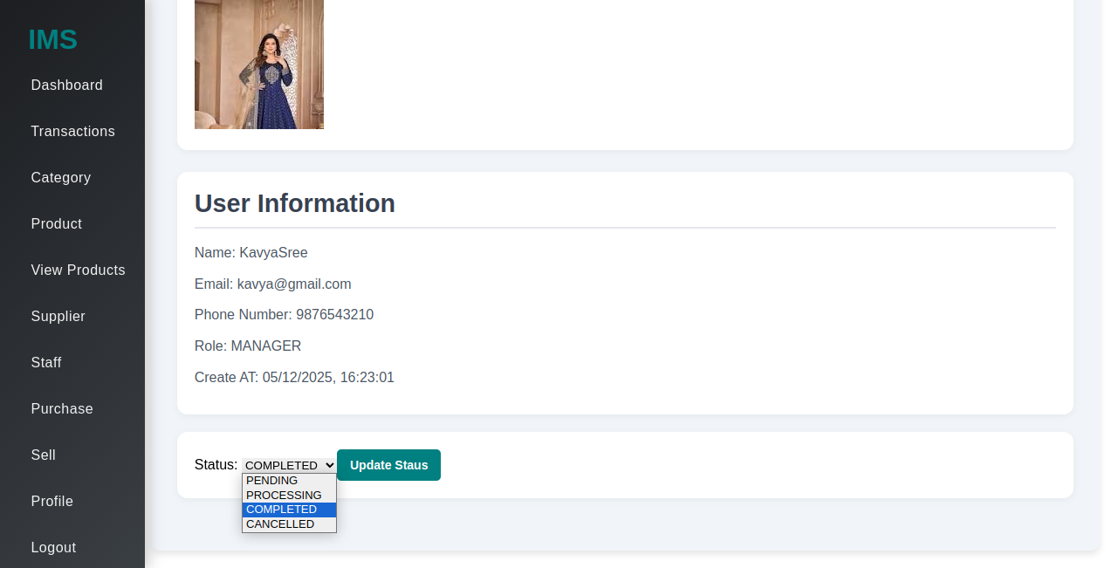
Update and Track Transaction Status Efficiently

Slide 22
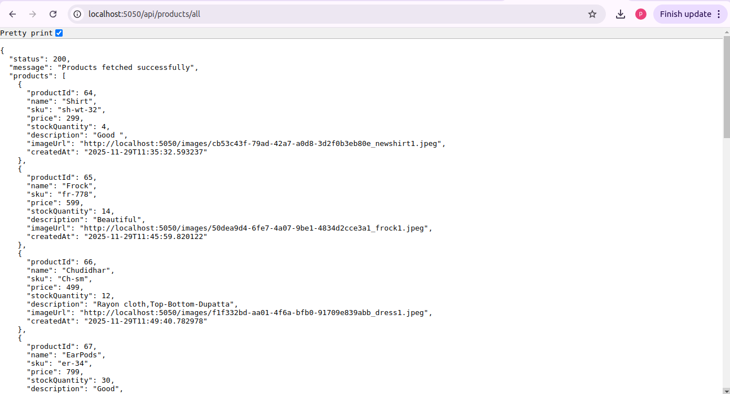
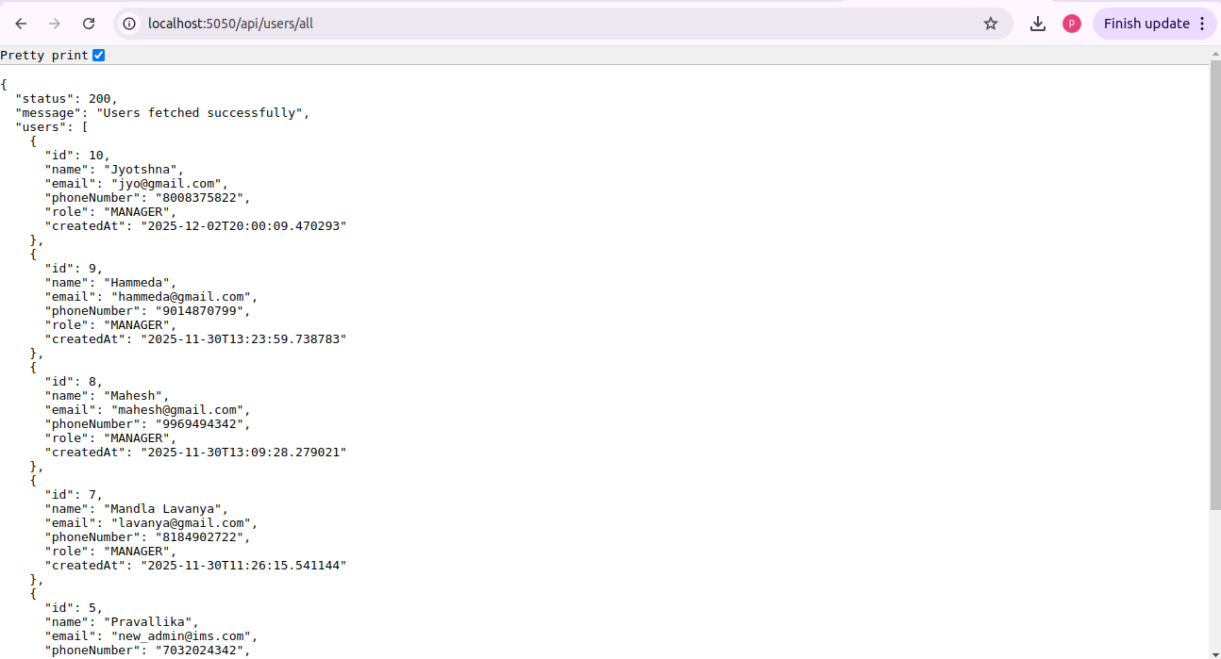
Products API
Staff API

Slide 23



Tech Stack
1. Frontend:
React.js (Dashboard, Transactions, Forms)
React Router (Page navigation)
Recharts (Charts & Data Visualization)
CSS (Custom styling)
2. Backend:
Java Spring Boot (RESTful APIs)
Spring Security (Authentication & Role-based Authorization)
Spring Data JPA (Database interaction)
3. Database:
MySQL (Products, Transactions, Users, Suppliers,Categories)
4. File & Media Management:
Local Storage / File System (Product images)

Slide 24
Conclusion
The Inventory Management System enhances accuracy, reduces manual effort, and streamlines stock operations. With real-time updates, automated alerts, and easy tracking, it ensures faster decision-making and smoother workflow. Overall, it improves efficiency and reliability across the entire inventory process.

Slide 25
THANK YOU

